Slide 1
Joel Grus Chap. 2 Crash Course in Python Chap. 3 Visualizing Data Chap. 4 Linear Algebra Chap. 10 PCA

Slide 2
Joel Grus Chaps. 14-16 Linear Classifier

Slide 3
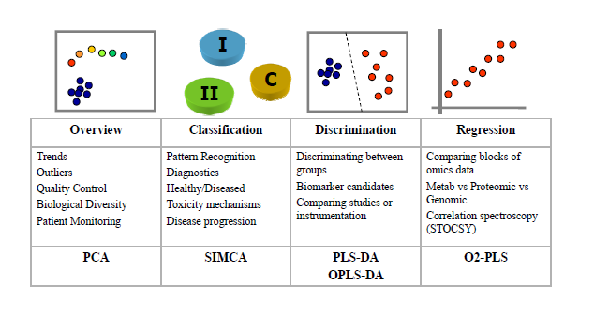
data analysis objectives

Slide 4
Neural Networks

Slide 5
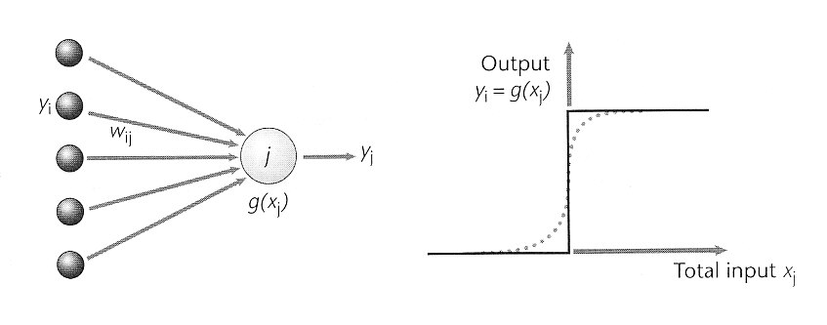
Single Neuron (Perceptron)
Connection from input to a neuron has positive/negative weight w_{ij}
Input x = (x₁, x₂, …, x_{d})^{T}
e.g. customer profile info (income, debt, employment years,...)
Output = 1 if (∑_{d} x_{i *} w_{i} – threshold) > 0
= -1 otherwise

Slide 6
Perceptron Example
Digit Detector

Slide 7
Perceptron Example
Two inputs, one output
Trained by
Total input x_{j} = w₁ x₁ + w₂ x₂ + w₀ (w₀ is bias)
Assume a step function for g(x_{j})
Can pick x₂ = ¼ + ½ x₁
- ½ x₁ + x₂ - ¼ > 0
(x₁ x₂) → y
(0, ½) 1
(1,1) 1
(1,1/2) 0
(0,0) 0
w₂ /2 + w₀ > 0
w₁ + w₂ + w₀ > 0
w₁ + w₂/2 + w₀ < 0
w₀ < 0

Slide 8
Perceptron
Given dataset: input x = (1, x₁, x₂, …, x_{d})^{T}
(x₁, y₁), … (x_{N}, y_{N})
Hypothesis h(x) = g(∑_{d} w_{i} * x_{i} – threshold)
= g(∑_{d} w_{i} * x_{i} + w₀ * x₀)
When g(.) = sign(.),
h(x) = sign(∑_{i=1,d} w_{i} * x_{i} + w₀) = sign(∑_{i=0,d} w_{i} * x_{i} )
= sign(w^{T}x)
Learning Algorithm:
for misclassified dataset that sign(w^{T}x) = h(x) != y_{n}
update weights by w = w + y_{n}x_{n}
if h(x) = -1 where y=1 => increase weights
if h(x) = 1 where y= -1 => decrease weights

Slide 9
Perceptron Learning Algorithm (PLA)
Set all w to 0
For N or until weights do not change
for each (x_{i},y_{i})
[learning]
h(x_{i}) = sign(w^{T}x)
If y_{i} – h(x_{i}) == 0, continue
else
w_{k} = w_{k-1} + (y_{i} – h(x_{i}))x_{ik}

Slide 10
Example: Iris
https://archive.ics.uci.edu/ml/datasets/iris
Sepal_L, Sepal_W, Petal_L, PetalW, type
6.6,2.9,4.6,1.3,Iris-versicolor
6.3,3.3,6,2.5,Iris-virginica
7.7,2.6,6.9,2.3,Iris-virginica
6.5,3.2,5.1,2,Iris-virginica
6.1,2.6,5.6,1.4,Iris-virginica
5,2,3.5,1,Iris-versicolor
6.7,3.3,5.7,2.1,Iris-virginica

Slide 11
matrix
(AB)^{T} = B^{T}A^{T}
w^{T}x = y
x^{T}w = y^{T}
A² = A^{T}A

Slide 12
Analysis
input x = (1, x₁, x₂, …, x_{d})^{T} --- column vector
output y
w^{T}x
w^{T}x = y
¹ ¹
^{x11 x21}
^{x12 x22}
.
.
^{x1d x2d}
w^{T}
x

Slide 13
Analysis
Data
input x = (1, x₁, x₂, …, x_{d}) -- row vector
output y^{T}
x^{T}w
x^{T}w = y^{T}
input x = (1, x₁, x₂, …, x_{d})^{T}
-- column vector
output y
w^{T}x
w^{T}x = y
x^{T}
¹ ¹
^{x11 x21}
^{x12 x22}
.
.
^{x1d x2d}
w
=
w^{T}
x
x^{T}
y

Slide 14
Python/numpy
zip
x=[[1,2],[3,4]]
y=[5,6]
a,b = zip(x,y)
where
a = array([0, 1, 2, 3, 4, 5, 6, 7, 8, 9])
np.where(a < 5, a, 10*a) => array([ 0, 1, 2, 3, 4, 50, 60, 70, 80, 90])
np.ravel
x = np.array([[1, 2, 3], [4, 5, 6]])
np.ravel(x) => array([1, 2, 3, 4, 5, 6])
X.flat: 1-D iterator over an array.
X.flatten:1-D array copy of the elements of an array in row-major order.
X.reshape:Change the shape of an array without changing its data.

Slide 15
Perceptron
x^{T}w = y^{T}
X*w = y
t = np.dot(X, w[1:0]) + w[0]
h = np.where(t>=0.0, 1, -1) estimator
def net_input(self, X):
return np.dot(X, self.w_[1:]) + self.w_[0]
def predict(self, X):
return np.where(self.net_input(X) >= 0.0, 1, -1)

Slide 16
Perceptron
def net_input(self, X):
return np.dot(X, self.w_[1:]) + self.w_[0]
def predict(self, X):
return np.where(self.net_input(X) >= 0.0, 1, -1)
class Perceptron(object):
def fit(self, X, y):
self.w_ = np.zeros(1 + X.shape[1]) # w = 0
self.errors_ = []
for _ in range(self.iter):
errors = 0
n = 0
for xi, target in zip(X, y): # for each (x_{i},y_{i})
update = self.eta * (target - self.predict(xi))
self.w_[1:] += update*xi # w_{k} = w_{k-1} + (y_{i} – h(x_{i}))x_{ik}
self.w_[0] += update
errors += int(update != 0.0)
n += 1
self.errors.append(errors)
return self

Slide 17
Regression
Statistical modeling
Estimating relationship among variables
Curve fitting
Linear
Polynomial
Logistic

Slide 18
Linear Regression
Given points, find a line with minimum projections
(x₁, y₁), (x₂, y₂), ….. (x_{N}, y_{N})
Curve fitting with a line
w = (w₀, w₁)^{T} for h(x,w) = w₀ +w₁x
w₀ w₁
1 1 1 ….
x₁ x₂ x₃ ….
?
y₁ y₂ ….
=

Slide 19
Linear Regression
Find w that minimizes the error:
E(w) = ∑ _{n}(h(x_{i}, w) – y_{i})²
[w₀ w₁] 1 1 1 .. + [e₁ e₂ e_{3 …}]
y = x₁ x₂ x₃ ..
= w^{T}x + e
Error function:
e(w) = [y – w^{T}x]^{T} [y – w^{T}x]/2

Slide 20
Linear Regression – Closed-form via LSM
Least Square Mean (LSM) Error
e(w) = [y – x^{T}w]^{T} [y – x^{T}w]/2
ΔE(w) = e(w)/ w
[y – x^{T}w]^{T} (-x^{T}) = 0
x[y – w^{T}x] = 0
xy = xx^{T}w
w = (xx^{T})⁻¹xy
For a linear line
w₁ = ∑(x_{i}-E[x])(y_{i}-E[y])/∑(x_{i}-E[x]))²
w₀ = E[y] – w₁*E[x]

Slide 21
Linear Regression
def net_input(self, X):
return np.dot(X, self.w_[1:]) + self.w_[0]
def predict(self, X):
return np.where(self.net_input(X) >= 0.0, 1, -1)
class LinearRegression(object):
def fit(self, X, y):
self.w_ = np.zeros(X.shape[1]+1)
self.cost_ = []
for i in range(self.iter):
output = self.net_input(X) # x^{T}w + e
error = y - output
self.w_[1:] += self.eta * np.dot(X.T, error)
self.w_[0] += self.eta * error.sum()
cost = np.dot(error.T, error)/2.0 #(error**2).sum()/2.0
self.cost.append(cost)
return self

Slide 22
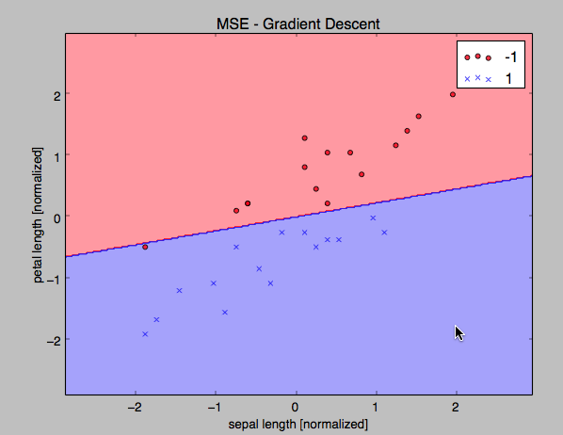
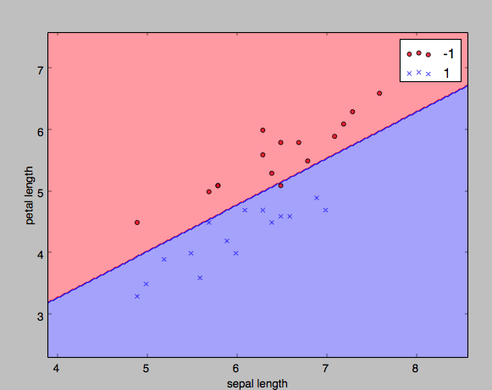

Slide 23
Polynomial Regression
Curve fitting by a polynomial of degree m
w = (w₀, w₁, .. ,w_{m}) for h(x,w) = w₀ +w₁x + w₂x² + … +w_{m}x^{m}
Given a dataset
(x₁, y₁), (x₂, y₂), ….. (x_{N}, y_{N})
Find w that minimizes the error:
E(w) = (1/N) ∑ _{N}(h(x_{i}, w) – y_{i})²
Least Square Mean (LSM) Error
y = X^{T}w + e
e = (1/N)(X^{T}w – y)²
ΔE(w) = (1/N)2X^{T}(X^{T}w-y) = 0
X^{T}Xw = X^{T}y
w = (X^{T}X)⁻¹X^{T}y
Pseudo-inverse: (X^{T}X)⁻¹X^{T}

Slide 24
Polynomial Regression
Target function
h(x,w) = w₀ +w₁x + w₂x² + … +w_{m}x^{m}
= w₀ + ∑ _{j=1}w_{j}x^{j}
= ∑ _{j=0}w_{j}x^{j}
= [1 x₀ x₁ … x_{n}] [w₀]
[w1]
= x^{T}w
Linear w.r.t. w

Slide 25
Logistic Regression
Total input x_{j} = ∑_{i}w_{ij} x_{i}
Output y_{j} = Θ(x_{j})
= 1/(1 + e^{-x})
Θ(x_{j})
sigmoid function or tanh()
can be interpreted as a probability
input x: cholesterol level, age, weight, …
Signal s = w^{T}x
Output Θ(s): prob. of heart attack
Θ(-x) = 1 - Θ(x),

Slide 26
Error Measure
For each (x, y), y is generated by probability f(x):
Plausible error measure based on likelihood:
if h=f, how likely to get y from x ?
p(y|x) = h(x) for y= +1
1 – h(x) for y = -1
Substitute h(x) = Θ(s) = Θ(w^{T}x)
Since Θ(-s) = 1 - Θ(s),
p(y|x) = Θ(yw^{T}x)

Slide 27
Error Measure
Likelihood of having (x₁,y₁), … (x_{N}, y_{N}):
Π_{n=1,N}p(y_{n}|x_{n}) = Π_{n=1,N}Θ(y_{n}w^{T}x_{n})
Maximize Σ_{n=1,N} ln(Θ(y_{n}w^{T}x_{n}))/N
Minimize -Σ_{n=1,N} ln(Θ(y_{n}w^{T}x_{n}))/N
= Σ_{n=1,N}ln(1/Θ(y_{n}w^{T}x_{n}))/N
= Σ_{n=1,N}ln(1 + exp(-y_{n}w^{T}x_{n}))/N
Error Measure:
E(w) = Σ_{n=1,N}ln(1 + exp(-y_{n}w^{T}x_{n}))/N

Slide 28
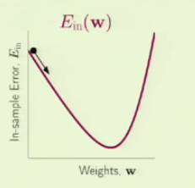
Minimizing Error Measure – Gradient Descent
E(w) = Σ_{n=1,N}ln(1 + exp(-y_{n}w^{T}x_{n}))/N
Start with w(0)
Use fixed step size η with unit vector v
ΔE = E(w(1)) – E(w(0))
= E(w(0) + ηv) – E(w(0))
= ηΔE(w(0))^{T}v + O(η²)
≥ -η||ΔE(w(0))||
Since v is a unit vector,
v = -ΔE(w(0))/||ΔE(w(0))||

Slide 29
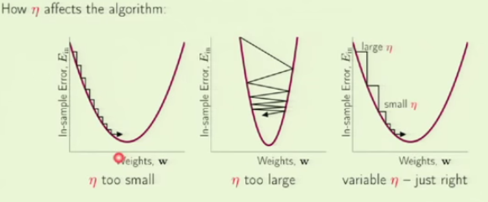
Implementation
η affects the performance
Instead of Δw = ηv = -η ΔE(w(0))/||ΔE(w(0))||
use Δw = -ηΔE(w(0)) (η: learning rate)
Rule of thumb: η=0.1

Slide 30
Gradient Descent
Minimize Error Measure:
E(w) = Σ_{n=1,N}E(h(x_{n}), y_{n})/N
= Σ_{n=1,N}ln(1 + exp(-y_{n}w^{T}x_{n}))/N for logistic
Difficult to apply to ALL samples at one time (batch)
Stochastic GD
Pick one (x_{n}, y_{n}) at a time
Apply GD to E(h(x_{n}), y_{n})
E_{n}[-ΔE(h(x_{n}), y_{n})] = Σ_{n=1,N}ΔE(h(x_{n}), y_{n})/N
= -ΔE (average direction)

Slide 31
Logistic regression algorithm
Initialize weights at t=0 to w(0)
For t = 1,2,….
compute the gradient
ΔE = - [Σ_{n=1,N} y_{n}x_{n} /(1 +
exp(-y_{n}w^{T}(t) x_{n})]/N
update weights: w(t+1) = w(t) – ηΔE
until Δw < threshold
Set all w to 0
For N or until weights do not change
for each (x_{i},y_{i})
[learning]
h(x_{i}) = sign(w^{T}x)
If y_{i} – h(x_{i}) == 0, continue
else
w_{k} = w_{k-1} + (y_{i} – h(x_{i}))x_{ik}

Slide 32
Perceptron
1
w₀
x₁
w₁
w₂
s
h
x₂
x_{d}
w_{d}
h_{i} = ∑_{d} x_{i *} w_{i}
Iterative updates of weights – learning algorithm
w_{k+1} <- w_{k} + y_{k+1}x_{k+1} for misclassified dataset that sign(w^{T}x_{n}) != y_{n}
w = np.zeros(X.shape[1] + 1)
for i in range(iter):
for xi, y in zip(X,y):
error = y – np.where(x_{i} ^{T} w_{i} >=0.0, 1, -1)
w[1:] += eta * np.dot(X, error)
w[0] += eta * error

Slide 33
Linear Regression
1
w₀
x₁
w₁
w₂
s
h
x₂
x_{d}
w_{d}
Linear Regression
E(w) = ∑ _{N}(h(x_{i}, w) – y_{i})²/2
Minimize E(w)
ΔE(w) = 0
Gradient descent
w = np.zeros(X.shape[1] + 1)
costs = []
for i in range(iter):
h = np.dot(X, w[1:]) + w[0]
error = y – h
w[1:] += eta * np.dot(X.T, error)
w[0] += eta * error.sum()
cost = (error**2).sum()/2.0
costs.append(cost)

Slide 34
Logistic Regression
1
w₀
x₁
w₁
w₂
s
h
x₂
x_{d}
w_{d}
w = np.zeros(X.shape[1] + 1)
costs = []
for i in range(iter):
s = np.dot(X, w[1:]) + w[0]
#ΔE = - [Σ_{n=1,N} y_{n}x_{n} /(1 + exp(-y_{n}w^{T}(t) x_{n})]/N
grad = np.dot(X.T,y)/(1+np.exp(np.dot(y, s.T)))
err = -grad.sum()/len(y)
#update weights: w(t+1) = w(t) – ηΔE
w[1:] += eta * err
w[0] += eta * err.sum()
cost = (error**2).sum()/2.0
costs.append(cost)
Logistic Regression
h_{j} = Θ(x_{j}) = 1/(1 + e^{-x})
E(w) = ∑ _{N}(h(x_{i}, w) – y_{i})²/2
= Σ_{n=1,N}ln(1 + exp(-y_{n}w^{T}x_{n}))/N
Minimize E(w)
ΔE(w) = 0
Gradient descent

